Slide 1

Thesis Presentation: Efficiency of LightGBM technique in Bankruptcy Prediction using Polish Data.
Big Data & Business Analytics SRH Hochschule Heidelberg
Shidharth Bammani(11011885)

Slide 2
OVERVIEW
Problem Statement
Research Questions
Business understanding
Data Understanding
Introduction to LightGBM
Comparison of Gradient boosting methods: XGBoost vs LightGBM
Benchmark: Statistical models for Bankruptcy Predictions
Results for LightGBM with parameter tuning
Conclusion and Future Scope

Slide 3
1.Problem Statement
What are the conclusion that can be drawn from the implementation of the newly introduced ensemble learning technique LightGBM in corporate bankruptcy prediction?

Slide 4
2.Research Questions
How well the LightGBM performs in terms of bankruptcy prediction comparing with the reference models?
How well the LightGBM model performs in comparison to XGBoost with sparse data and class imbalance?
Can we improve the corporate bankruptcy prediction by implementing the Light-GBM GOSS technique to the highly skewed Polish bankruptcy dataset?

Slide 5

3.Business Understanding
In this section:
What is bankruptcy?
What is bankruptcy prediction?
Challenges in bankruptcy prediction

Slide 6
What is Bankruptcy?
Bankruptcy is a legal status of a person or other entity that cannot repay debts to creditors.
In most jurisdictions, bankruptcy is imposed by a court order, often initiated by the debtor.
Bankruptcy is different from insolvency. Bankruptcy is of the several legal statuses that an insolvent person/entity may end up with.
Bankruptcy offers an individual or business a chance to start fresh by forgiving debts that simply cannot be paid, while offering creditors a chance to obtain some measure of repayment based on the individual's or business' assets available for liquidation.
Upon the successful completion of bankruptcy proceedings, the debtor is relieved of the debt obligations incurred prior to filing for bankruptcy.

Slide 7
What is Bankruptcy Prediction?
Bankruptcy prediction is the art of predicting bankruptcy and various measures of financial distress of public firms.
It is a vast area of finance and accounting research and is important due in part to the relevance for creditors and investors in evaluating the likelihood that a firm may go bankrupt.
The history of bankruptcy prediction includes application of numerous statistical tools which gradually became available, and involves deepening appreciation of various pitfalls in early analyses
The area is well-suited for testing of increasingly sophisticated, data-intensive forecasting approaches.

Slide 8
Challenges in Bankruptcy Prediction
The data about bankrupt and solvent companies is difficult to collect and in most of the successful collection scenarios, it ends up being sparse.
The quantity of research is a function of the availability of data: for public firms which went bankrupt or did not, numerous accounting ratios that might indicate danger can be calculated, and numerous other potential explanatory variables are also available.
Since all the companies don’t operate on the same timelines, it is difficult to gather meaningful data about bankrupt companies or otherwise.
The features on which the bankruptcy prediction is based, are not as straightforward as the financial ratios found on the balance sheets of the companies.

Slide 9

4.Data Understanding
In this section:
Polish bankruptcy data: Description
Data organization and Instances
Features
Data Quality Assessment
Missing Data
Data imbalance

Slide 10
Polish Bankruptcy Dataset: Description
The dataset is about bankruptcy prediction of Polish companies.
The data was collected from Emerging Markets Information Service (EMIS), which is a database containing information on emerging markets around the world.
The bankrupt companies were analyzed in the period 2000-2012, while the still operating companies were evaluated from 2007 to 2013.
All data files have multivariate data and is intended to be used for classification task.
All the features are numeric (Real) values and data set has missing values.

Slide 11
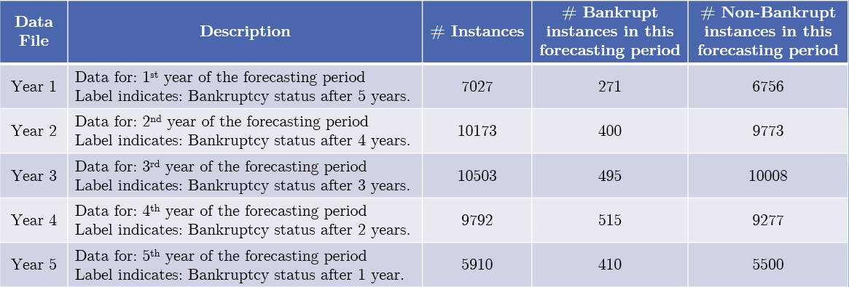
Data organization and Instances
Basing on the collected data five classification cases were distinguished, that depends on the forecasting period:

Slide 12
Features
There are a total of 64 features in the dataset, where each feature is constructed using two or more core econometric indicators.
Hence each feature is actually a synthetic feature.
The synthetic features are formulated by performing arithmetic operation(s) on the core indicators.
The purpose of the synthetic features is to combine the econometric indicators into complex features.
The synthetic features have high dimentionality.

Slide 13
Features
ID | Description
X1 | net profit / total assets
X2 | total liabilities / total assets
X3 | working capital / total assets
X4 | current assets / short-term liabilities
X5 | [(cash + short-term securities + receivables - short-term liabilities) / (operating expenses - depreciation)] * 365
X6 | retained earnings / total assets
X7 | EBIT / total assets
X8 | book value of equity / total liabilities
X9 | sales / total assets
X10 | equity / total assets
X11 | (gross profit + extraordinary items + financial expenses) / total assets
X12 | gross profit / short-term liabilities
X13 | (gross profit + depreciation) / sales
X14 | (gross profit + interest) / total assets
X15 | (total liabilities * 365) / (gross profit + depreciation)
X16 | (gross profit + depreciation) / total liabilities
ID | Description
X17 | total assets / total liabilities
X18 | gross profit / total assets
X19 | gross profit / sales
X20 | (inventory * 365) / sales
X21 | sales (n) / sales (n-1)
X22 | profit on operating activities / total assets
X23 | net profit / sales
X24 | gross profit (in 3 years) / total assets
X25 | (equity - share capital) / total assets
X26 | (net profit + depreciation) / total liabilities
X27 | profit on operating activities / financial expenses
X28 | working capital / fixed assets
X29 | logarithm of total assets
X30 | (total liabilities - cash) / sales
X31 | (gross profit + interest) / sales
X32 | (current liabilities * 365) / cost of products sold

Slide 14
Features
ID | Description
X33 | operating expenses / short-term liabilities
X34 | operating expenses / total liabilities
X35 | profit on sales / total assets
X36 | total sales / total assets
X37 | (current assets - inventories) / long-term liabilities
X38 | constant capital / total assets
X39 | profit on sales / sales
X40 | (current assets - inventory - receivables) / short-term liabilities
X41 | total liabilities / ((profit on operating activities + depreciation) * (12/365))
X42 | profit on operating activities / sales
X43 | rotation receivables + inventory turnover in days
X44 | (receivables * 365) / sales
X45 | net profit / inventory
X46 | (current assets - inventory) / short-term liabilities
X47 | (inventory * 365) / cost of products sold
X48 | EBITDA (profit on operating activities - depreciation) / total assets
ID | Description
X49 | EBITDA (profit on operating activities - depreciation) / sales
X50 | current assets / total liabilities
X51 | short-term liabilities / total assets
X52 | (short-term liabilities * 365) / cost of products sold)
X53 | equity / fixed assets
X54 | constant capital / fixed assets
X55 | working capital
X56 | (sales - cost of products sold) / sales
X57 | (current assets - inventory - short-term liabilities) / (sales - gross profit - depreciation)
X58 | total costs /total sales
X59 | long-term liabilities / equity
X60 | sales / inventory
X61 | sales / receivables
X62 | (short-term liabilities *365) / sales
X63 | sales / short-term liabilities
X64 | sales / fixed assets

Slide 15
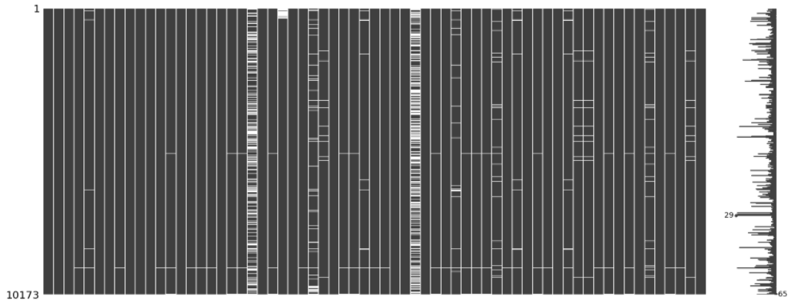
Data Quality Assessment: Missing data
Figure: Sparsity matrix for dataset ‘Year 2’. The white spaces indicate missing data values for the feature in the corresponding column.

Slide 16
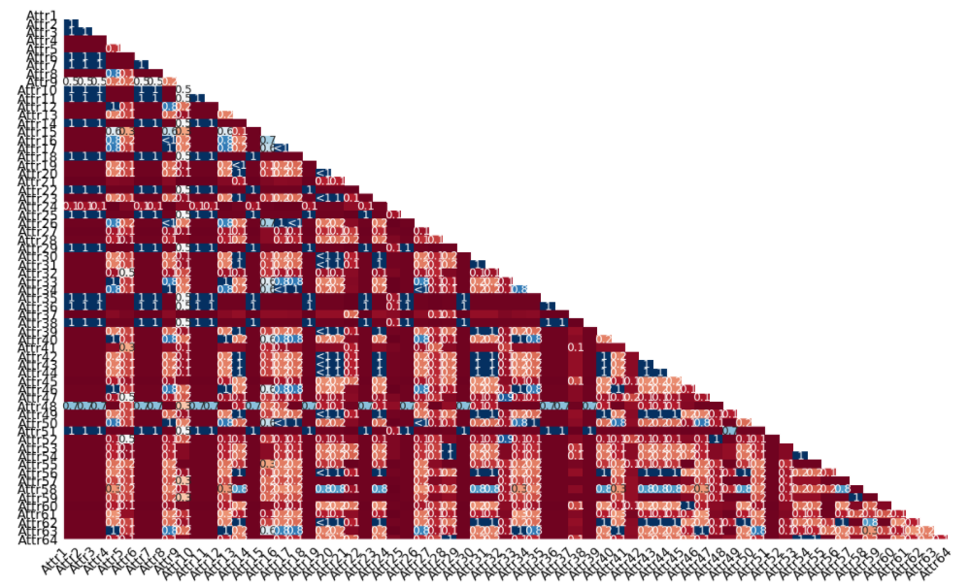
Data Quality Assessment: Missing data
Figure: Heatmap for dataset ‘Year 2’.
Describes the degree of nullity relationship between different features.
The range of this nullity correlation is from -1 to 1 (-1 ≤ R ≤ 1).
R=1 indicates when the first feature and the second feature both have corresponding missing values.
(R=-1) means that one of the features is missing and the second is not missing.
There are features that are not essentially correlated (R values close to 0)

Slide 17
Data Quality Assessment: Missing Data
Data Set | # Total Instances | # Instances with missing values | # Instances that would remain if all rows with missing values were dropped | % Data loss if rows with missing values were dropped
Year 1 | 7027 | 3833 | 3194 | 54.54 %
Year 2 | 10173 | 6085 | 4088 | 59.81 %
Year 3 | 10503 | 5618 | 4885 | 53.48 %
Year 4 | 9792 | 5023 | 4769 | 51.29 %
Year 5 | 5910 | 2879 | 3031 | 48.71 %

Slide 18
Data Quality Assessment: Data Imbalance
Data Set | # Instances | # Bankrupt instances in this forecasting period | # Non-Bankrupt instances in this forecasting period | Percentage of minority class samples
Year 1 | 7027 | 271 | 6756 | 3.85 %
Year 2 | 10173 | 400 | 9773 | 3.93 %
Year 3 | 10503 | 495 | 10008 | 4.71 %
Year 4 | 9792 | 515 | 9277 | 5.25 %
Year 5 | 5910 | 410 | 5500 | 6.93 %

Slide 19

5.Introduction to Light GBM
In this section:
What is Gradient Boosting framework
What is Light GBM
Growing the decision tree
Finding the best split
Ignoring Sparse inputs
Subsampling the data: GOSS
Hyper-parameters tuning

Slide 20
What is Gradient Boosting Framework?
Gradient Boosting technique consists of three main principals.
Weak learners
Gradient Optimization
Boosting Technique
We have a lot of trees and each tree given below are build sequentially.
First tree learns how to fit target variables.
Second tree learns how to fit residuals between the actual output and the weighted sum of predictions until an iteration before.
The third tree learns how to fit residuals of the second tree.
Notes:
. In each iteration GBDT learns the decision tree by fitting the residual errors (errors upto the current iteration). This means every subsequent learner tries to learn the difference between actual output and weighted sum of predictions until an iteration before. The errors are minimised using the gradient method.
To calculate the best split requires the model to go through various splits and compute the criterion for each split. There is no analytical solution for determining the best split at each stage. As we will see later, this is one of the key challenges when training GBDTs.

Slide 21
What is LightGBM?
LightGBM is an open-source framework for gradient boosted machines.
LightGBM can be used by to train the following:
Gradient Boosted Decision trees (GBDT)
Dropouts meet Multiple Additive Regression trees (DART)
Gradient based One sided sampling (GOSS)
LightGBM provides highly optimized, scalable and fast implementations of gradient boosted machines (GBMs).

Slide 22
Growing Decision tree:
The Key difference in GBDT and LightGBM is the trees are grown leaf wise.
Every node in a level will have child nodes resulting in an additional layer of depth.
Leaf-wise tree growth strategy tend to achieve lower loss as compared to the level-wise growth strategy, but it also tends to overfit, especially small datasets.
Notes:
the leaf-wise tree growth finds the leaves which will reduce the loss the maximum, and split only that leaf and not bother with the rest of the leaves in the same level. This results in an asymmetrical tree where subsequent splitting can very well happen only on one side of the tree.

Slide 23
Finding the best split
In GBDT finding the best split takes a lot of computational time.
LightGBM finds the best split by using histogram based method.
The features are grouped into set of bins before building trees.
Equivalent to subsampling the number of split the model will evaluate.
This method increases the training speed and reduces computational complexity.
Notes:
Firstly the number of bins creates a trade-off between speed and accuracy: the more bins there are, the more accurate the algorithm is, but the slower it is as well. Secondly, how to divide the features into discrete bins is a non-trivial problem: dividing the bins into equal intervals (the most simple method) can often result in an unbalanced allocation of data. Though the details are beyond the scope of this post, the "most balanced" method of dividing the bins actually depends on the gradient statistics

Slide 24
Ignoring the sparse data:
Light GBM works well with the tabular data, and the input tends to be sparse.
It treats the missing values as zero’s and overlooks it when computing split and allocates them to whichever side of the tree that reduce the loss.
Hence LightGBM algorithm can take care of missing values.

Slide 25
Subsampling data: GOSS
Gradient based one sided sampling is exclusively used in LightGBM.
The observation is not all the data points contribute equally to training the model.
The training data with small gradients tends to learn the best.
It is more efficient to focus on data points with larger gradients.
The data with small gradients are randomly sampled.
It increases the weight of the samples with small gradients when computing the change in loss.

Slide 26
Hyper parameter tuning
Based on the problem the model’s parameters are set to get the best outcome.
Some of the important parameters are mentioned below.
num_leaves:
feature_fraction:
max_bin:
boosting_type:
objective: binary
max_depth:
Notes:
num_leaves is one of the most important parameters that controls the complexity of the model.
you set the maximum number of leaves each weak learner has
Feature fraction or sub_feature deals with column sampling, LightGBM will randomly select a subset of features on each iteration (tree). For example, if you set it to 0.6, LightGBM will select 60% of features before training each tree.
There are two usage for this feature:
Can be used to speed up training
Can be used to deal with overfitting
Binning is a technique for representing data in a discrete view(histogram). Lightgbm uses a histogram based algorithm to find the optimal split point while creating a weak learner.

Slide 27
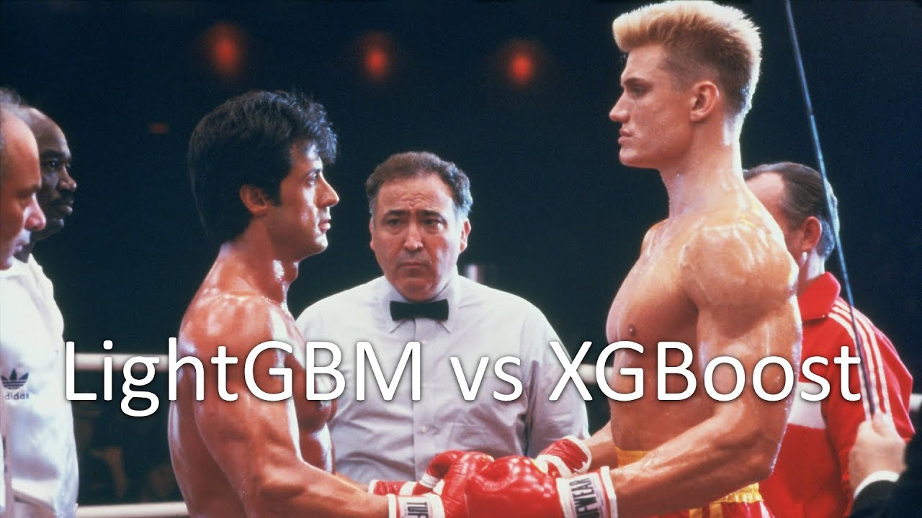
6.Comparison of Gradient boosting methods: XGBoost vs LightGBM
In this section:
Results of XGBoost
Comparison of XGBoost and LightGBM results

Slide 28
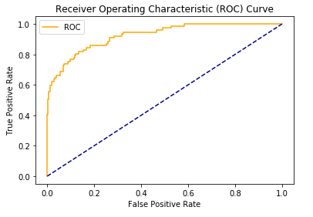
Results of XGBoost

Slide 29
Comparison of XGBoost and LightGBM results
Model | AUC score train | Auc score test | Training time
XGBoost | 1.0 | 0.94 | 0.82 sec
LightGBM | 1.0 | 0.92 | 5.35 sec

Slide 30

7.Benchmark: LightGBM comparison with models
In this section:
Data preparation
Reference models
Modelling pipeline
Results

Slide 31
Data Preparation
Dealing with missing data
MICE Imputation
Dealing with data imbalance
SMOTE Oversampling

Slide 32
Reference models
Gaussian Naïve Bayes
Logistic Regression
Random Forest
Decision Trees
XGBoost

Slide 33
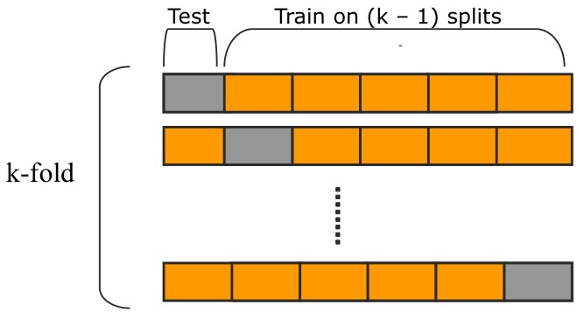
Modelling pipeline
Raw Data
(.arff files)
Formatted 5 Years’ Data
MICE
Imputation
SMOTE Oversampling
Modeling with 6 models: (using K-Fold CV)
GNB, LR, DT, RF, XGB, LGB
Results

Slide 34
Results
Models | Accuracy | Precision | Sensitivity | Specificity
Gaussian Naïve Bayes | 50% | 50% | 98% | 3%
Logistic Regression | 44% | 44% | 43% | 44%
Random Forest | 92% | 91% | 93% | 90%
Decision tress | 91% | 90% | 93% | 89%
XGBoost | 97.4% | 98% | 97% | 97%
LightGBM | 98.6% | 98% | 98% | 98%

Slide 35
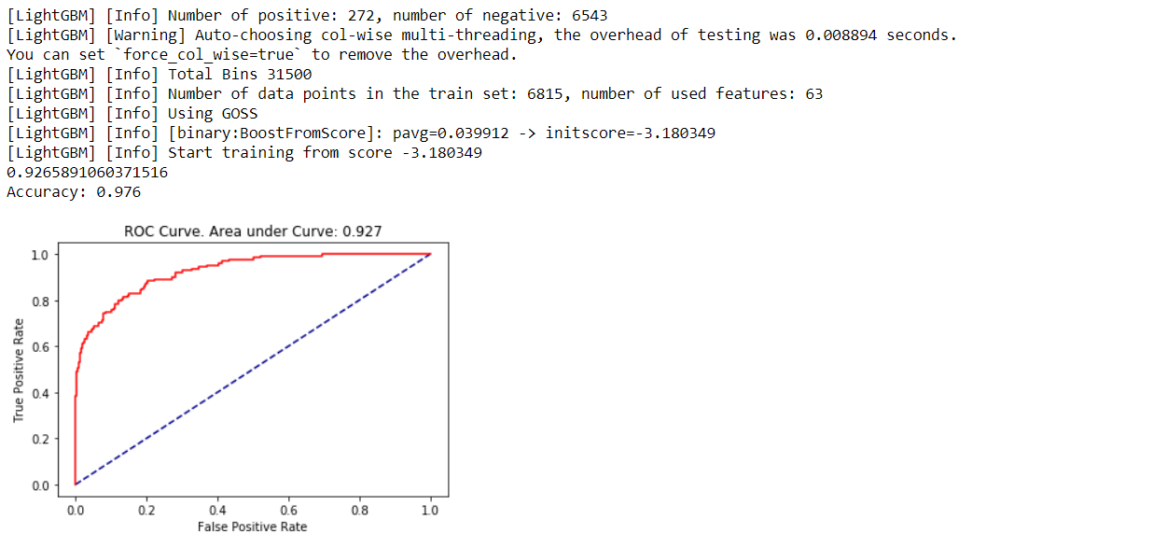
Results achieved by using hyper parameter tuning

Slide 36

8.Conclusion & Future Scope

Slide 37
Conclusion
After looking at the results , we can say that LightGBM performs well with bankruptcy data.
The statistical models like Logistic Regression and Gaussian Naïve Bayes perform poorly with bankruptcy data.
Decision trees and Random forest perform well but not satisfactory results are achieved.
XGBoost has similar computational power to LightGBM but we see in the comparison that LightGBM has the edge over XGBoost in terms of binary classification problem of bankruptcy prediction.

Slide 38
Future Scope
Such a promising model can be implemented in real life use cases for bankruptcy prediction in corporate companies.
The idea is to switch from XGBoost to LightGBM in the future for specific problems.
The data used for implementation as we know was not satisfactory to achieve best results although if the models is trained with better financial data then we can see some other insights that are missed.

Slide 39

Thank you!!

